Slide 1
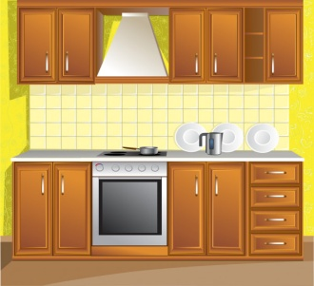
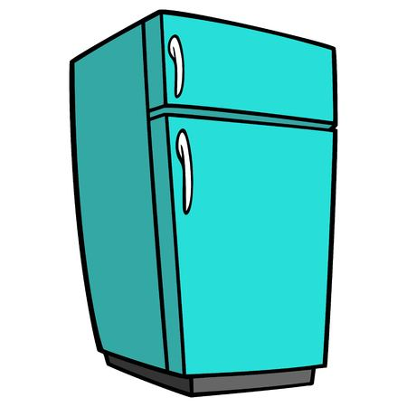



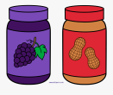
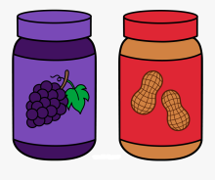






How to feed a Martian
*Martian is at your home alone *He speaks a little English *You only have ingredients for a peanut butter jelly sandwich
Pull
Go to Kitchen
Open the refrigerator
Find bread + peanut butter + jelly
Open 1st drawer
Grab the spreader
Twist the cap
Scoop some from each
Spread
Put the breads (peanut butter jelly side) together -
Open your mouth and chew
Bon Appétit ☺

